Slide 1
Unit testing
Presenters : Quang Le, Tham Vo, Khoa Nguyen

Slide 2
Agenda
Introduction
“Shoot ‘em up” application
Boundary Testing
Equipvalent Class Partitioning
Tools & Practices

Slide 3
introduction

Slide 4
Boundary Test

Slide 5
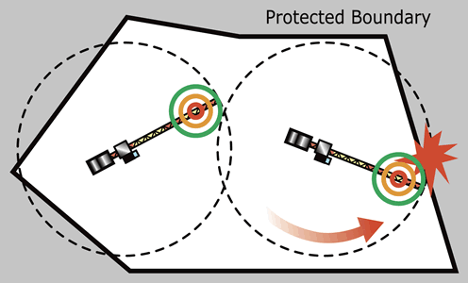
BOUNDARY TEST
Focus on the boundaries of the input space to identify test cases
What is the rationale for using this technology?

Slide 6
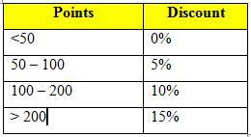
BOUNDARY TEST
How to apply
Test at the boundaries
Test boundary’s adjacent values
Test nominal value for each partition
Test for single fault assumption
Problems
Apply discount for customers base on the their point then calculate the order total
0
50
100
200

Slide 7
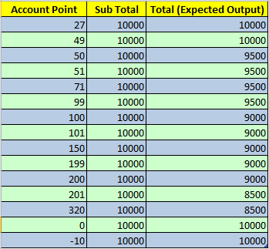
BOUNDARY TEST
Test cases

Slide 8
Equivalence class (EQC)

Slide 9
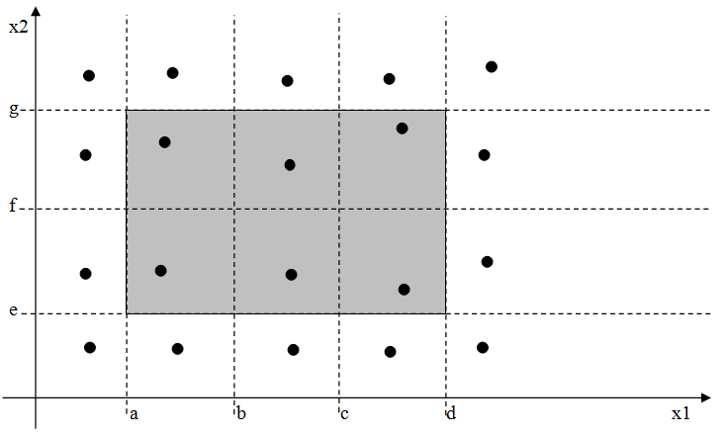
EQC
Classifying Inputs and Outputs into classes whereas values in the same class produce same behaviors.
Choosing Test cases by picking only 1 value for a value domain in which all values performs the same behavior to test

Slide 10
EQC – Shoot ‘EM UP
New account requirement:
UserName should contain lowercase and upper case alphabet, numeric characters
UserName should have minimum length of 8 and maximum length of 20
Password should have minimum length of 8 and maximum length of 20
Password should not contain “SPACE”

Slide 11
EQC – Shoot ‘EM UP
UserName classes:
Valid
Less than 8 characters
More than 20 characters
Contains special characters
Empty
Null

Slide 12
EQC – Shoot ‘EM UP
Password classes:
Valid
Less than 8 characters
More than 20 characters
Contains “SPACE”
Empty
Null

Slide 13
EQC – Shoot ‘EM UP
And More ….

Slide 14
Tools and practices

Slide 15
Tools
Nunit
MS UnitTest Framework
Moq, Rhino Mock
Profiler

Slide 16
Practices
Use Mock/Fake
Data-Driven Testing (Data Pool Testing)
Don’t ignore special cases
A testcase can depend on other programs but should not depend on other testcases
Large Testcase for Valid inputs and Small Testcases for invalid inputs
Use White-Box methods to explore all the path
Expect Exceptions instead of Assert Exception

Slide 17
Thank you

